Slide 1
Our Homes, Our Votes: Forming Partnerships in Your Community June 3, 2024

Slide 2
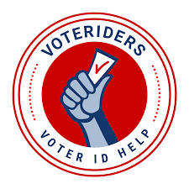
Agenda
Resources for voter ID assistance
Selene Gomez, national outreach director, VoteRiders
Civic Health Month
Marcos Damian-Noyola, partnerships manager, VOT-ER
Q&A
Our Homes, Our Votes opportunities and new resources

Slide 3
Housekeeping Items
This webinar is being recorded.
Recording, slides, and links will be distributed in our Friday email newsletter, “The Connection,” and recording will be posted on NLIHC YouTube channel by the end of the week
Closed captioning is enabled
Use the Q&A feature to ask questions throughout the webinar
Ensure respectful dialogue in the chat
Our Homes, Our Votes is 100% nonpartisan

Slide 4
Selene Gomez
National Outreach Director
VoteRiders

Slide 5
Voter ID and the 2024 Elections:
What You Need to Know + What We Can Do
FEBRUARY 2024

Slide 6
12 YEARS ON THE GROUND
VoteRiders was founded in 2012 as a response to an increase in voter ID laws. We work to provide clear information and direct help to all voters.
WORKING NATIONWIDE
We work year-round with eligible voters
who don’t have IDs.
We help voters get any ID they need
and deliver accurate information about
voter ID rules to communities across
the country.
NON-PARTISAN MISSION
We are committed to ensuring that every eligible American is able to exercise their freedom to vote.

Slide 7
Working Nationwide and On the Ground
AZ
FL
GA
Our free tools and services are available to anyone who wants to help their community vote with confidence.
NC
OH
VoteRiders’ resources are relevant for the entire voting public.
PA
Our 2024 on-the-ground programs are strategically focused in 8 states.
TX
WI

Slide 8
Voter ID Laws in 2024
17 states
have new or stricter voter ID laws since 2020, impacting
in-person and mail voting
34.5 million +
voting-age citizens do not have a current driver’s license or state ID
EXISTING VOTER ID LAW
NEW OR STRICTER LAW SINCE 2021
NO VOTER ID LAW
Source: University of Maryland, VoteRiders

Slide 9
FINDINGS: WHO LACKS ID?
14.8%
Voting-age citizens in the United States do not have an unexpired driver’s license or state ID with their current name and address on it
That is more than 34.5 million people!
Notes:
Link to Report:

Slide 10
FINDINGS: WHO LACKS ID?
47%
DO NOT HAVE A DRIVER’S LICENSE WITH
THEIR CURRENT NAME AND/OR ADDRESS
Unequal Impact
Americans who are disproportionately less likely to have a current driver’s license include:
Black Americans
Latinx Americans
Americans who do not have a high school diploma or college degree
BLACK AMERICANS
Americans with lower annual incomes
Age 18-29
Young Black Americans are least likely to have a driver’s license with their current name and/or address.
30%
DO NOT HAVE ANY DRIVER’S LICENSE

Slide 11
FINDINGS: BARRIERS TO ID ACCESS
Respondents without a driver’s license who identified bureaucratic or economic factors as the reason they do not have one
19%
Identified barriers include: cost of getting
a license, financial or legal difficulties
(like unpaid tickets or fines), lack of time,
or lack of underlying documents

Slide 12
FINDINGS: WHO LACKS ID?
2 OUT OF EVERY 10
AMERICANS LIVING
IN VOTER ID STATES
DO NOT HAVE A CURRENT DRIVER’S LICENSE

Slide 13
FINDINGS: VOTER CONFUSION
Widespread Confusion
More than half of the Americans living
in states where a photo ID is required to vote in person do not know their state’s voter ID law
More than half of the Americans living in states where a photo ID is required to vote in person do not know their state's voter ID law and are not aware of the specific type of ID they will need to successfully cast a ballot.
Many Americans living where photo ID isn't required are also confused about their state's voter ID law.

Slide 14
VOTER ID IN 2024
What You Can Do About It

Slide 15
VoteRiders.org
Voter ID State Info Pages
2024 updates prioritizing plain language and highlighting recent rule changes
Voter ID details for voting in person and by mail
Full list of accepted IDs and any alternative options for your state
Links to request ID help from VoteRiders, download info cards, and access your state’s official website
English and Spanish

Slide 16
ACTION ALERT
Bookmark your state page now!
VoteRiders.org/YourStateName
Make a plan to share it widely!

Slide 17
Voter ID Info Cards
Wallet-sized cards highlighting key voter ID info
All 50 states and DC
English and Spanish
Available free for non-profit, non-partisan orgs
Freely downloadable and printable
Crucial backup for voters facing misinformed pollworkers
Newly designed for 2024!

Slide 19
ACTION ALERT
Order voter ID info cards now!
VoteRiders.org/Cards
VoteRiders.org > Partner > Order Info Cards
Notes:
receive them about two weeks. If you ask for English and Spanish, they will send them separately.
No PO Boxes.
They could put the order through the coordinator.

Slide 20
Voter ID Trainings
Specialized training focused on specific state laws
National training focused on best practices
Virtual or in person
Joint Outreach
Co-branded materials and special projects
Virtual volunteer events

Slide 21
HOW IT WORKS
Direct Voter Contact
Partnerships
Ask about voter ID when contacting voters
Partners leading voter outreach efforts can incorporate our ID resources and free assistance offers into their digital or
in-person programs.
Share “voter Ieads” data with VoteRiders
Trained volunteers follow up with voters who need assistance

Slide 22
Volunteer Events
Virtual and in-person opportunities
Letter writing, phone banking, and text banking
Often co-hosted with partners to conduct targeted voter outreach
Thousands of VoteRiders volunteers working across the country
Contact voters year-round to offer ID information and assistance

Slide 23
Voter ID Helpline and Chatbot
Hi! I’m with VoteRiders.
How can I help?
I turned 18 a few days ago and am super excited to vote, the only problem is that I don’t have a driver’s license and my school ID doesn’t have anything like a signature or expiration date.
VoteRiders staff and volunteers assist voters through our bilingual Voter ID Helpline and
one-on-one conversations.
(I’m a senior in high school)
Call or text 866-ID-2-VOTE (866-432-8683)
So I was wondering if you could help me figure out what I could
do so I can start voting as soon
as I can?
VoteRiders.org/FreeHelp
My name is Olivia and I’m happy to help! What state do you live in? Voter ID rules are different in every state.
Helpline@VoteRiders.org
Chat on Facebook, Instagram, website

Slide 24
Voter ID Assistance
Getting ID costs money and can take a lot of time
VoteRiders helps voters track down key documents and secure the ID need to cast a ballot that counts
We cover the cost of vital documents, arrange transportation to ID-issuing offices, and provide pro bono legal assistance if necessary

Slide 25
Voter ID Clinics
One-on-one assistance for voters
In person and virtual
VoteRiders covers all costs associated with the ID process
Clincs can be scheduled on a recurring basis or as a single event
Virtual ID assistance is available on flexible days and times

Slide 26
How to Refer Voters for ID Assistance
Partners can refer voters to VoteRiders and get a case started through:
Partner referral form through VoteRiders.org/IDform
VoteRiders.org/FreeHelp
Sharing our Voter ID Info Cards or Helpline number

Slide 27
Digital Assets on Voter ID
Ready-made sample language to share urgent voter ID information and calls to action via email, newsletters, and social media.
Specialized Resources
Trans and Nonbinary Voters: VoteRiders.org/Pride
Student Voters: VoteRiders.org/Student
Voters with Disabilities: VoteRiders.org/Disabilities

Slide 28
@VoteRiders
VoteRiders.org/Partner
Info@VoteRiders.org

Slide 29
QUESTIONS?
Thank you for joining us!

Slide 30
Marcos Damian-Noyola
Senior Partnerships Manager
VOT-ER

Slide 31
Nonpartisan healthcare- based civic engagement
Proudly in partnership with ...
... and over 350 additional hospitals, clinics, & healthcare associations
Join the movement at vot-er.org
@vot_er_org
Notes:
[Please make a copy of this presentation before editing by going to File > Make A Copy. You can also download it to PPT if you prefer.]
Thank you so much for the opportunity to talk to you today about Vot-ER (pronounced: “Vote ER”), an exciting initiative to bring voter registration into the healthcare space. Vot-ER works to provide patients the opportunity to register to vote, as the reality is that much of our healthcare system and healthcare experiences are determined by the policies our elected officials implement.
Over 350 hospitals, clinics, and health associations across all 50 states along with 50,000 health professionals use Vot-ER’s resources and tools to support voter engagement, and Vot-ER has been featured in The New York Times, the Washington Post, PBS NewsHour, and more.

Slide 32
The Link Between Voting & Health
Join the movement at vot-ER.org
@vot_er_org
Notes:
[More slides on this are in our Civic Engagement and Health Presentation, feel free to add these if you want to include them or speak to them!]

Slide 33
Global, national, state, and local research shows a link between voter participation and health outcomes
Join the movement at vot-ER.org
@vot_er_org
Notes:
We can see this relationship nationally, with the Health Democracy index:
States with less voting access have worse health, while states with more voting access have better health.

Slide 34
Voting
STRUCTURAL DETERMINANTS OF HEALTH
The upstream causes of the causes
Voting is arguably the most important aspect of the political determinants [of health]”
SOCIAL DETERMINANTS OF HEALTH
The causes of poor health
Daniel Dawes
Author, The Political Determinants of Health
HEALTH-RELATED
SOCIAL NEEDS
Effects of the causes
Join the movement at vot-ER.org
@vot_er_org
Notes:
We cannot begin to address the social determinants of health until we begin to address and point our interventions towards the structural determinants of health.
And that is where voting plays in the upstream causes of the causes is where voting is most effective.

Slide 35
The problem is, too many people do not have a seat at the table to vote…
=
72 Million
Unregistered voters in the United States
Entire population of France
Join the movement at vot-ER.org
@vot_er_org
Notes:
Vot-ER came out of a realization of a major issue with our democracy and our healthcare systems here in the U.S. 72 million eligible people are not registered to vote in America--the amount of the entire population of France.

Slide 36
... often because they have never been asked
Have you been asked to register to vote in any of the following ways?
62% of unregistered eligible voters have never been asked to register
Source: Pew Charitable Trusts 2017. “Why are milliions of citizens not registered to vote?”
Join the movement at vot-ER.org
@vot_er_org

Slide 37
We see these same Americans as our patients
People most marginalized by our current health system
Unregistered eligible voters
Young,
low-income,
and people of color
Join the movement at vot-ER.org
@vot_er_org
Notes:
When you look at the top three groups of people who disproportionately make up those 72 million unregistered voters, they’re people who are young, low-income, and people of color. And when you see the patients who come in to see us for low acuity complaints and the patients who are most marginalized by our current healthcare system, it’s these same three groups. What if these patients were asked to register to vote? How would this begin to transform their health care experience?
[If you have a personal story illustrating this connection, this is a great place to share it. Feel free to make a copy of these slides so you can add in your own photos. You can then ask the audience “Raise your hand if you resonate with this story or have a similar story from your clinical work?”]

Slide 38
How Vot-ER Helps
Join the movement at vot-ER.org
@vot_er_org

Slide 39
Vot-ER creates easy-to-use, nonpartisan tools and programs for civic engagement in clinical spaces
Badges & lanyards for teams and organizations
Custom digital materials for teams and organizations
Email, text, and EHR templates that help staff & patients to vote
Join the movement at vot-ER.org
@vot_er_org

Slide 40
Vot-ER tools are...
undisruptive
optional
nonpartisan
Join the movement at vot-ER.org
@vot_er_org
Notes:
I know we’re always looking for ways to show our commitment to voting rights and health equity - and registering our patients with Vot-ER’s help is an easy, nonpartisan way to do that. Vot-ER is completely optional, won’t interrupt our providers as they care for patients, and is politically neutral.

Slide 41
Legal FAQs
Join the movement at vot-ER.org
@vot_er_org

Slide 42
There is long-standing precedent and federal guidelines for voter registration in 501(c)(3) spaces
501(C)(3) organizations may conduct nonpartisan voter engagement activities designed to help the public participate in elections:
voter registration
voter education
get-out-the-vote (GOTV)
The National Voter Registration Act of 1993 actually encourages this type of non-partisan voter registration in health centers!
Join the movement at vot-ER.org
@vot_er_org
Notes:
We’re all familiar with the way that DMVs are equipped to register patients to vote. Why can’t we do the same in our hospitals and clinics? Voter registration belongs in the hospital, just as much as in the DMV. And Americans often have more regular interaction with their healthcare providers than with DMVs, so bringing voter registration to our hospitals would be an important touchpoint. Vot-ER’s platform ensures that providers remain nonpartisan and confident when helping patients register to vote.
IRS guidelines
Nonprofit Vote has released a set of legal guidelines to help nonprofit organizations understand what they can and cannot do in regards to voting issues. “501(c)(3) organizations may conduct nonpartisan voter engagement activities designed to help the public participate in elections such as voter registration, voter education, and Get Out the Vote (GOTV) work.”
[Note to Aliya to revisit this page, check against 1 pager language]

Slide 43
Clinicians and healthcare organizations can...
Point patients to Vot-ER posters, badges, or handouts
Tell patients that their institution offers a service to help them register to vote, but they do not endorse any political party.
Help a patient fill out the registration form while remaining neutral.
Join the movement at vot-ER.org
@vot_er_org
Notes:
This means that clinicians and healthcare organizations can:
Point patients in the direction of posters/handouts or introduce the Healthy Democracy Kit--and let the software guide them through the process
Say that we are offering a service to patients to register to vote but we do not endorse any political party
And help a patient complete their registration form, while remaining neutral.
The 1993 National Voting Registration Act (which you may know as the Motor Voter Act) actually encourages this type of non-partisan voter registration at healthcare centers!

Slide 44
Take the Next Step
Join the movement at vot-ER.org
@vot_er_org

Slide 45
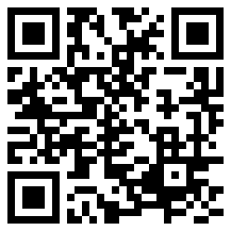
Order your FREE Custom Materials for Organizations and/or Order your FREE Vot-ER badge TODAY!
link.vot-er.org/order-materials
link.vot-er.org/order-badge
Join the movement at vot-ER.org
@vot_er_org

Slide 46
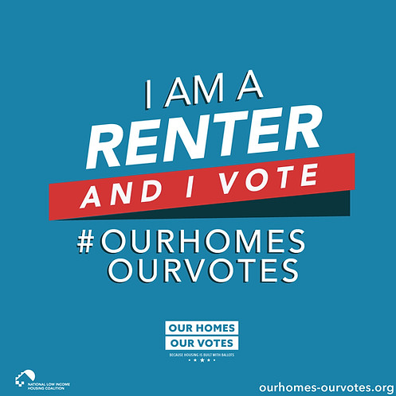
Questions?

Slide 47
Affiliates Network
Open to all nonpartisan organizations that share campaign’s goals
Regular office hours, email listserv, and post-election virtual gathering
Office hours Friday, 6/7, from 1-3pm ET
Enhanced access to Our Homes, Our Votes tools and resources
Sign up: www.ourhomes-ourvotes.org/affiliates

Slide 48
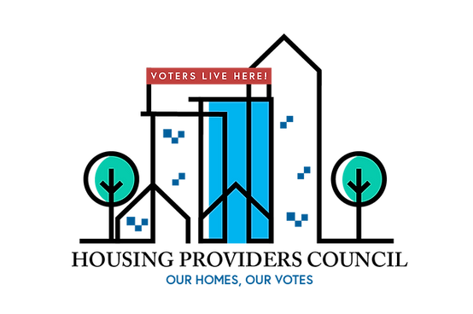
Housing Providers Council
Nonpartisan group of housing developers, property managers, and resident services staff committed to boosting voter turnout among their residents
Regular virtual meetings (bimonthly in 2024) to exchange ideas and receive trainings on best practices in nonpartisan voter engagement
More info and application link: https://www.ourhomes-ourvotes.org/housing-providers-council

Slide 49
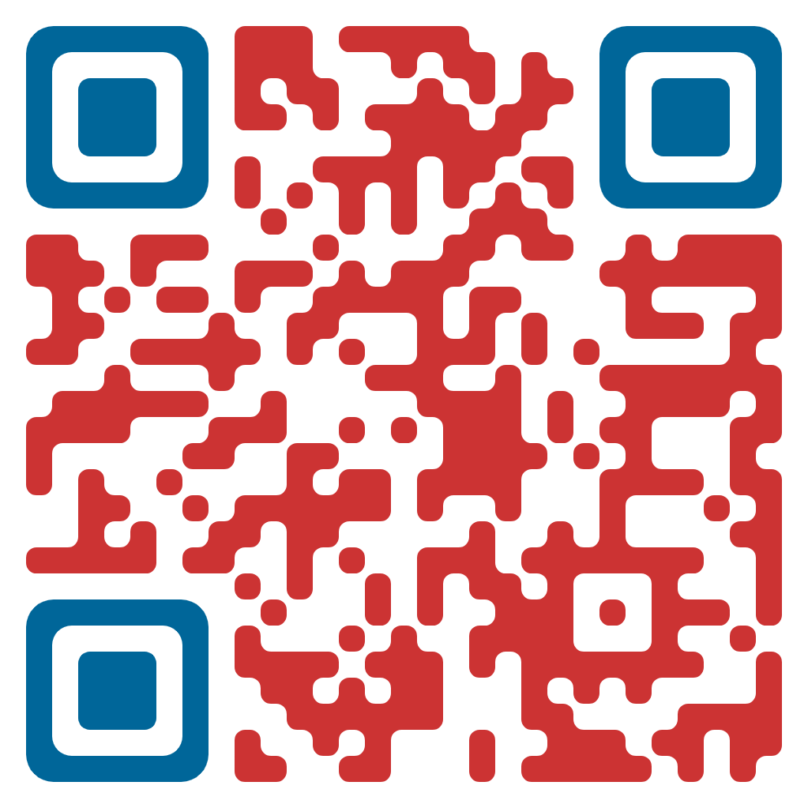
OurHomes.TurboVote.Org
Register to vote and update your voter registration, check your voter registration status, find election information for your community, and sign up for election reminders!

Slide 50
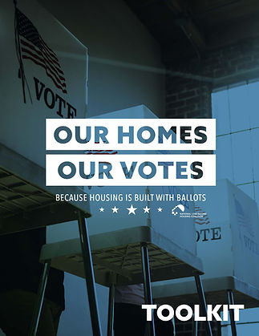
Our Homes, Our Votes Educational Resources
Comprehensive online resource library
Visit: https://www.ourhomes-ourvotes.org/resources

Slide 51
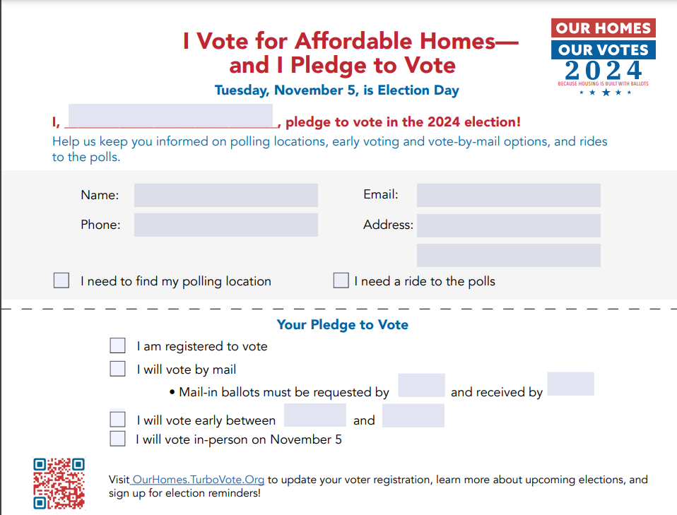
New Resource: Voter Pledge Card!

Slide 52
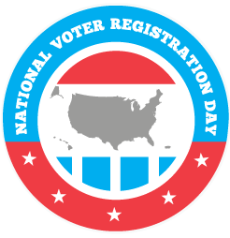
National Voter Registration Day
https://nationalvoterregistrationday.org/2024-partner-sign-up/?partner=nlihc24&source24=pp
Save the date: Tuesday, September 17, 2024
Sign up to become a community partner
https://nationalvoterregistrationday.org/2024-partner-sign-up/?partner=nlihc24&source24=pp
Benefits of community partnership
Posters, stickers, and other swag
Digital assets including posters and toolkits, state-by-state guides, and webinars
Updates about events and grant opportunities
Expectations
Stay nonpartisan
Host voter registration activities in your community

Slide 53
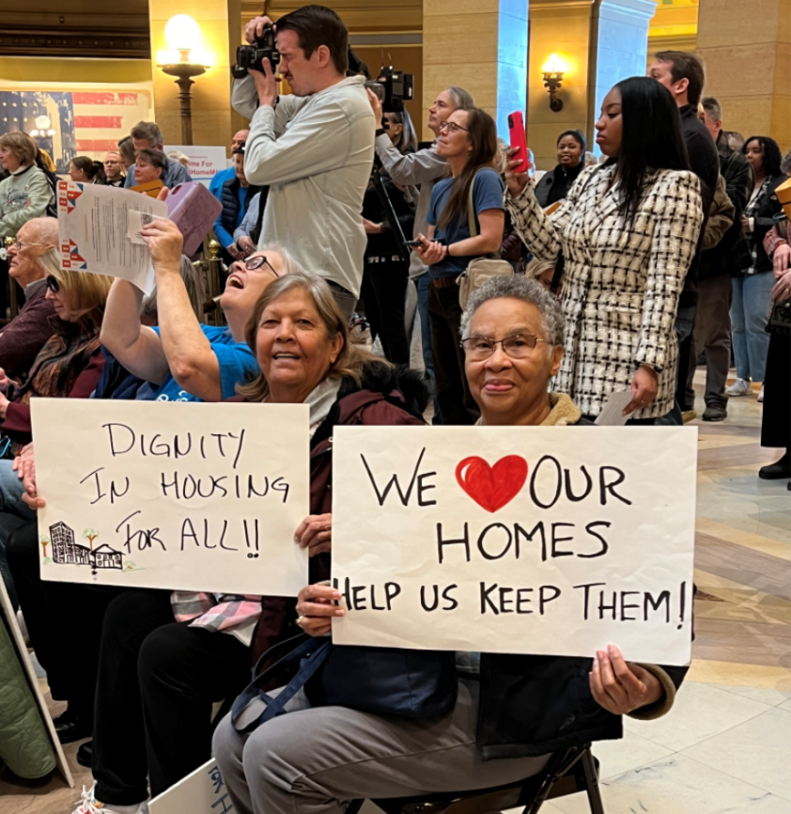
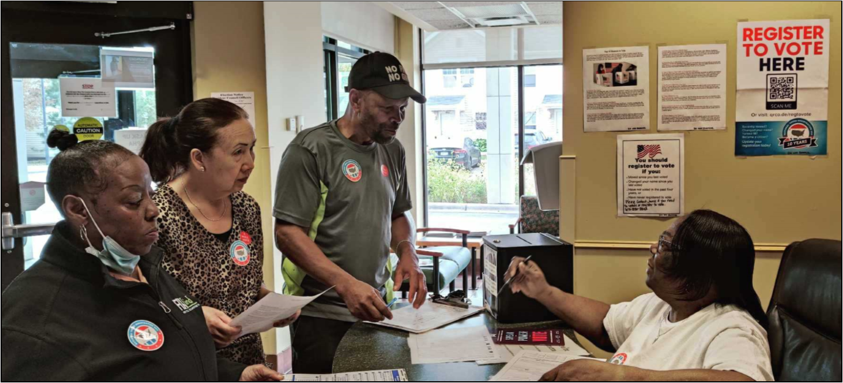
Next Webinar: Tenant Organizing and Elections (Monday, 6/17)
Featuring leaders from Minneapolis Highrise Representative Council!

Slide 54
Preview: Full Webinar Series
Monday, June 17 – Tenant Organizing and Elections: Getting Out the Renter Vote
Monday, July 1 – Voting While Experiencing Homelessness
Monday, July 15 – Transportation to the Polls
Monday, July 29 – Housing Providers and Voter Engagement
Monday, August 19 – Getting Candidates on the Record About Housing and Homelessness
Tuesday, September 3 – Celebrating the Civic Holidays
Monday, September 16 – Voter Education: The Who, What, Where, When, Why, and How
Monday, September 30 – Voter Education: Combating Misinformation and Disinformation
Monday, October 7 – Overcoming Voter Suppression
Monday, October 21 – Countdown to Election Day: Getting Out the Vote!
Monday, November 4 – Knowing Your Rights: Voter Protection on Election Day
Monday, November 18 – A Look Ahead: Next Steps for Civic Engagement and the Housing Justice Movement

